Slide 1




Class & ID
Class: 8
Lab : 23

Slide 2





Class
The class attribute specifies
one or more class names
for an HTML element

Slide 3
Usage of Class
The class name can be used
by CSS and JavaScript to
perform certain tasks for
elements with the specified
class name.

Slide 4

Class with JS
When a user clicks on a button, hide all elements with the class name “something“ can easily done by JavaScript

Slide 5
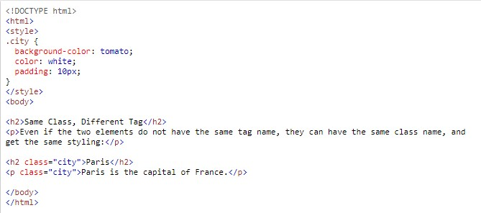
Same Class, Different Tag
Different tags, like <h2> and <p>,
can have the same
class name and
thereby share the
same style:

Slide 6
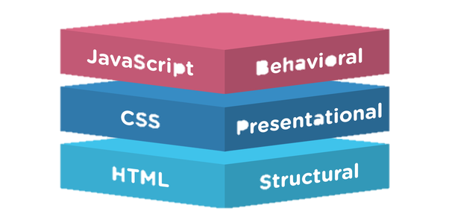
The id Attribute
The id attribute specifies a
unique id for an HTML
element (the value must be
unique within the HTML document)

Slide 7
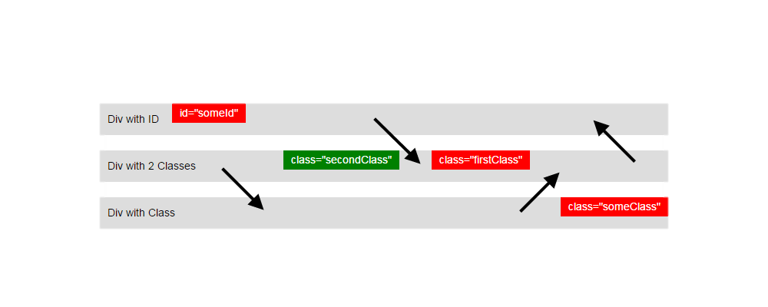
Class vs Id
An HTML element can
only have one unique id
that belongs to that
single element, while
a class name can be used
by multiple elements:

Slide 8



